Slide 1
Circular economy
Profir Andrei
Roman Matei
Toia Andrei

Slide 2
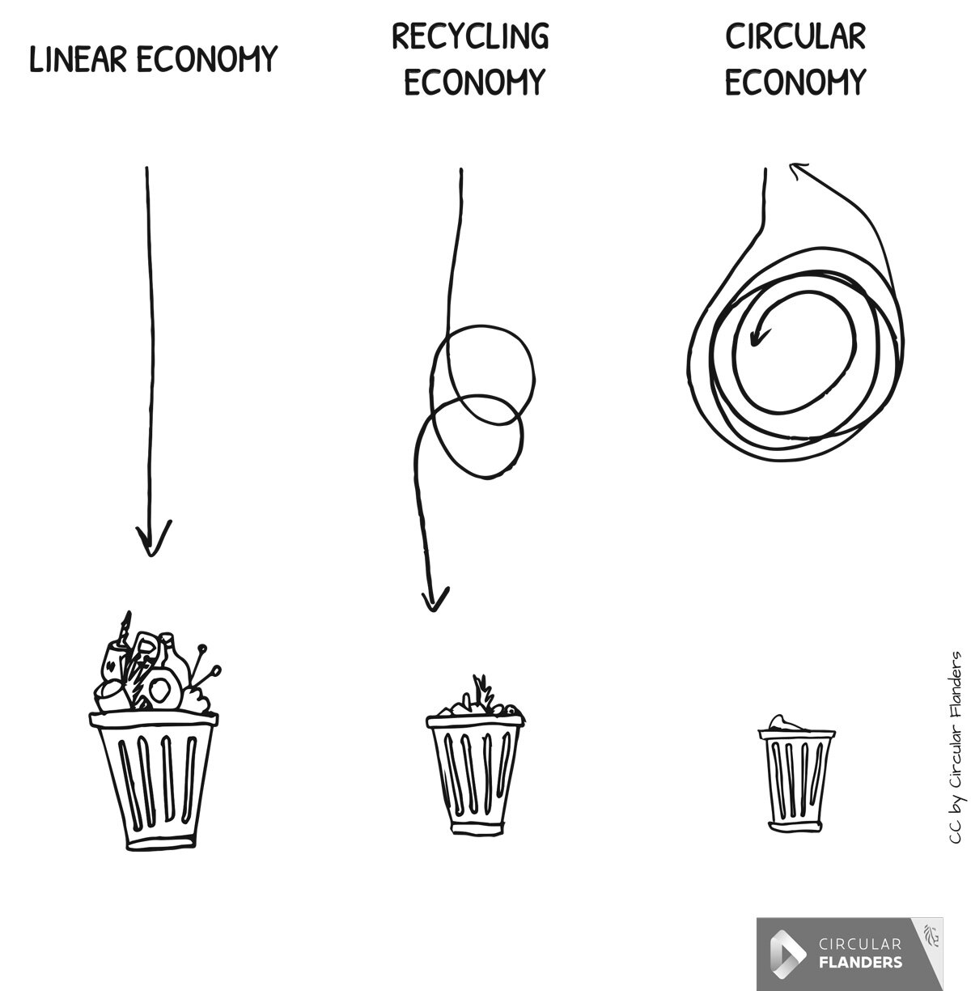
What is circular economy?
The circular economy is a way of shifting products, business models, communities and societies to a more circular system, similar to those found in natural cycles where nothing is wasted. This new vision for a more sustainable future isn’t just a theory, but is being put into practice and into Government strategies as a solution that really has potential to chart a new path from exploitation to regeneration.

Slide 3
Innovative business models : Rheaply
-Rheaply makes underused resources more visible with its asset exchange manager software. The B2B software opens up sharing opportunities for the global economy, enabling organisations to make the most of tools and equipment that would otherwise remain idle.
Why it’s an example of the circular economy
-By surfacing and sharing unused assets between and within businesses and institutions, the value of the items is preserved and there’s also a greater emphasis on maintenance and repair. In turn, there’s less demand to purchase new, often costly items that are only used once or twice in a lifetime.
How it works
-Rheaply’s asset exchange manager:
-lets users keep track of inventory
-allows items to be sold, donated or rented
-provides data insights to build a picture of asset use with its visualised waste diversion report.

Slide 4
Examples of circular economy in our country
Carrefour Romania runs “Punem Preţ pe Plastic”, a circular economy program aimed at reducing the amount of plastic packaging and introducing plastic into a responsible circuit, through reduction, reuse and recycling.
Auchan has launched a circular clothing economy program. In the stores included in the program, customers will be able to find, in addition to the clothing collections from the stores' offer, a selection of worn clothes, in perfect condition.

Slide 5
Comparison between global circular economy and national circular economy
Looking back at the examples, we can see that our country may not be that advanced as others in the circular economy, since we just started practicing it, but for sure we are on the right path and we look forward implementing new and improved solutions to stop wastage.

Slide 6
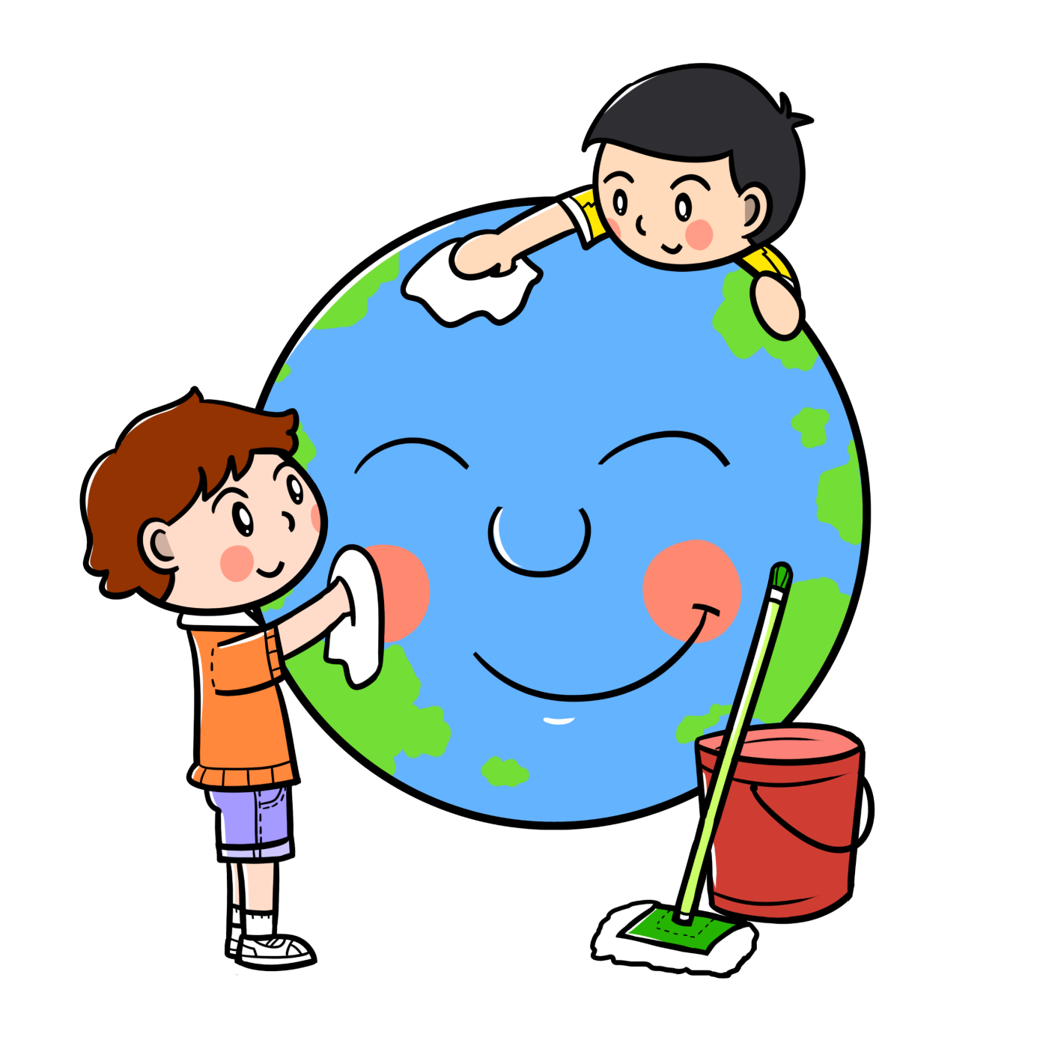
The conclusion
Circular economy is a must that needs to be implemented in every product that we use/consume so that future generations can have a relatively clean planet to live on. You can do something, it doesn't matter if you aren't part of a big company, you can start with yourself then you can teach others a different and more clean way of living. We must protect our planet!

Slide 7
Bibliography
https://www.fooddrinkeurope.eu/resource/fooddrinkeuropes-position-on-the-circular-economy-action-plan/
https://ellenmacarthurfoundation.org/regions/europe
https://ec.europa.eu/environment/topics/circular-economy/first-circular-economy-action-plan_en
https://www.loopsustainability.com/blog/what-is-the-circular-economy
https://ellenmacarthurfoundation.org/circular-examples-collection-innovative-business-models
https://www.zf.ro/supliment-zf-green-economy/este-economia-circulara-solutia-pentru-criza-de-mediu-care-este-la-20042604
https://pngtree.com/free-graphic-design

